Slide 1
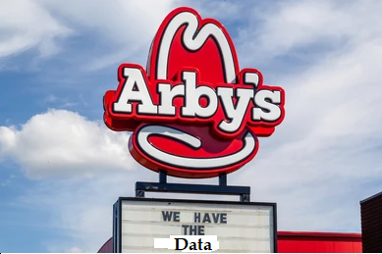
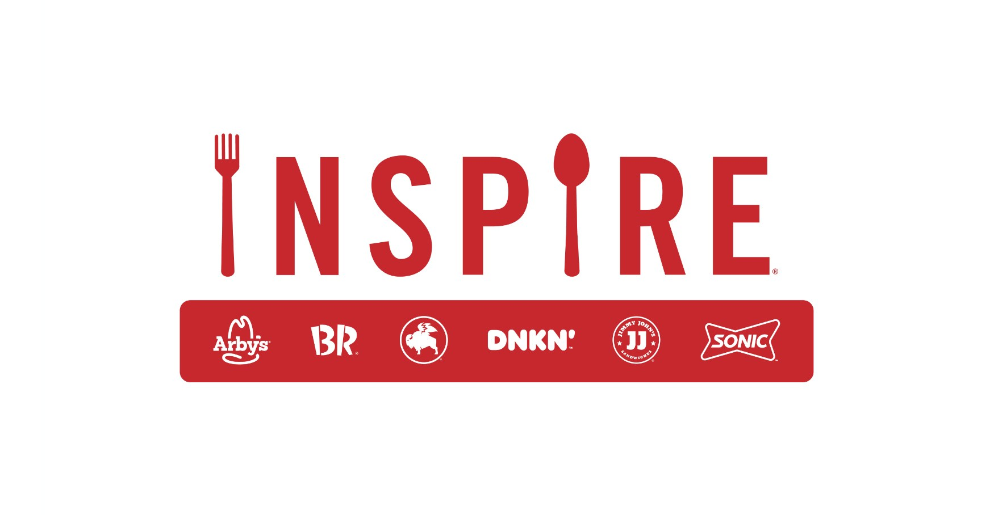
Arby’s Case Study Inspire Brand
Shreyas Kulkarni

Slide 2
Data Available
4 years of daily sales all over the US in all the available restaurants
Restaurant details
Day by Day weather condition (Min/max/avg temp, rain, snow, storm)
Competition in the proximity
Marketing efforts
Promotional offers (print data)

Slide 3

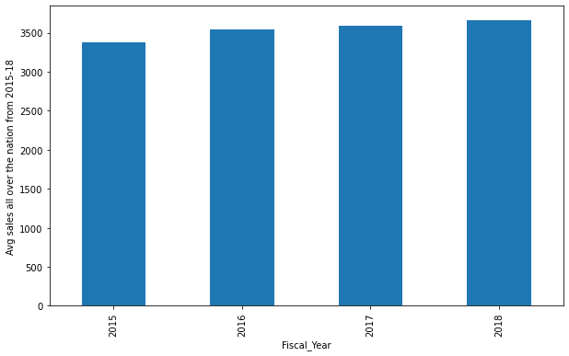
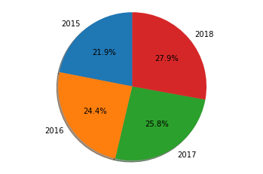
Interesting Insights
1169 Restaurants, 72 DMAs, ~ $5.4 B revenue in 50 states over the 4 years
Highest revenue coming from MI, followed by OH and IN, whereas a lot of scope of improvement in major states CA, TX and WA.
The business is growing exponentially every year.

Slide 4

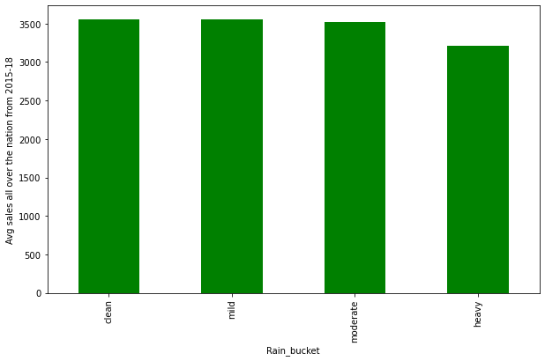

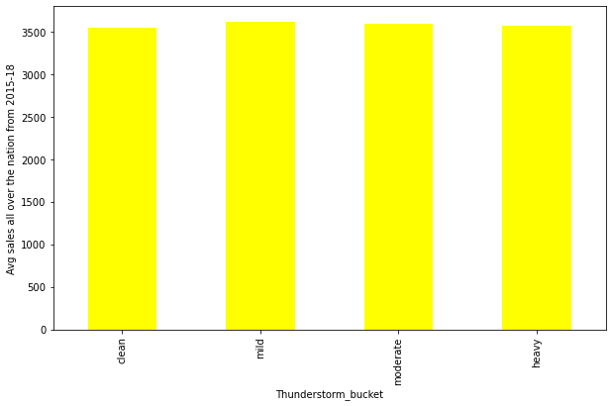
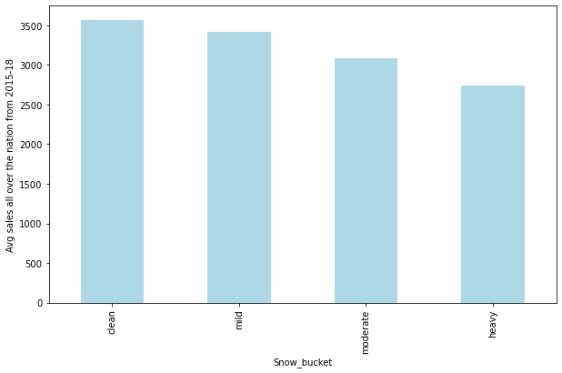
Impact of weather
In all the states of storm, the revenue remains almost the
constant indicating, Arby’s keep shinning in the thunderstorm too :P
Whereas, increasing snow and rain affects the business by
considerable margin

Slide 5
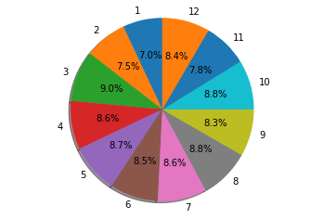
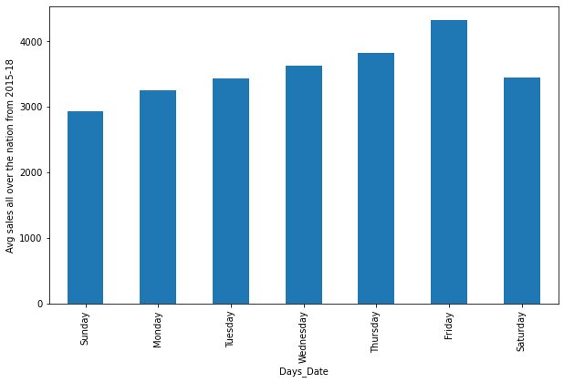
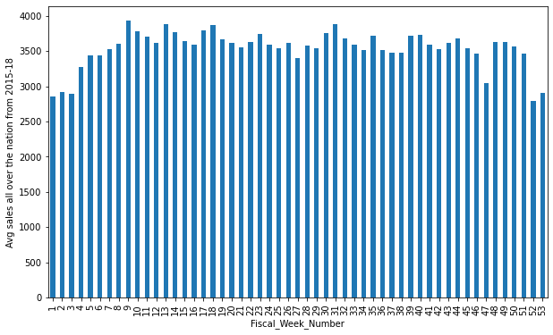
Seasonality : Month and week
Out of all months, march scores highest daily average revenue with narrow margin,
Whereas during entire holiday session, avg daily sales remain low surprisingly
Maximum average daily sales occurs on Friday

Slide 6
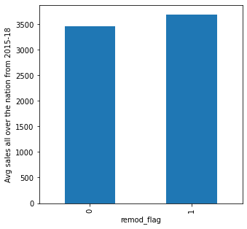
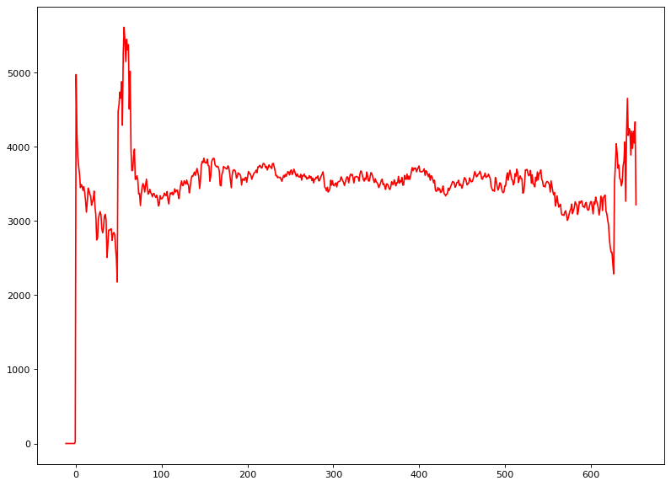
Age and remodeling:
Remodeling the shop helps increasing the sell. Here’s the visual which backs that. It increases the daily average sales by $250 after that.
As age of the shop decreases the average revenue. That has been the trend. As the age increases by months, sales starts dropping eventually

Slide 7
Effects of Print and Media
I ran the regression model with and without print and media programs and observed the predicted results.
Here are the interesting outcomes:
Situation | Predicted average daily sales per restaurant | Lift | Percentage lift if present
With both media and print | 3595.14 | - | -
Without only print | 3537.46 | 57.68 | 1.631%
Without only media | 3314.16 | 280.98 | 8.478%
Without anything of them | 3256.48 | 338.66 | 10.400%

Slide 8
Further Marketing Improvements
We observed that as TRP increases, sales increases. So, we can implement more advertising campaigns
Remodeling the restaurants have huge impact on the sales. So, Inspire Brand can encourage the owners to remodel the restaurants to improve the sales
We can provide print coupons more frequently
We can extend this analysis to state and DMA level and see how much competition is affecting. We can come up with the offers accordingly
We can increase the scope of the analysis by including more restaurant features like food type, customer transactions to analyze the more factors which can impact sales

Slide 9
We can use the social media too accordingly based on the finding of customer demographics and food type for the marketing. Right now we are just showing the ads on TV. Social media and targeted offers can increase the reach of the restaurants
By partnering with the delivery service companies
By offering the loyalty programs to the customers
While opening the new shop, we can use the above findings to come up with the most optimized location and the menu
Forecasting menu demand along with the sales.
Focus the DMAs where daily average sales is less, bucketize them and find out the impacting factors per DMA
Whenever the sales is less as per the prediction (Weekdays, holiday seasons) we can offer more promos

Slide 10
Forecasted weekly sales
2019 forecasted sales for all the restaurants are attached in ArbysForecastedSales2019_week.csv
The forecasts have been generalized for all the restaurants. However, we can improve the predictions further by finding out the relationship between the sales and impacting factors per restaurant or atleast DMA/State.
We can use better multivariate multistep forecasting models like VAR or LSTM which can fit to the patterns better than SARIMAX.
We can create additional features which are seasonal and affecting the sales
Constant factors like age, state have been ignored in this scope which can give better insights

